Slide 1
Hashing
Dr. Yingwu Zhu

Slide 2
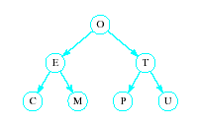
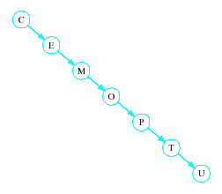
What do I have?
Recall order of magnitude of searches
  Linear search O(n)
  Binary search O(log₂n)
  Balanced binary tree search O(log₂n)
  Unbalanced binary tree can degrade to O(n)

Slide 3
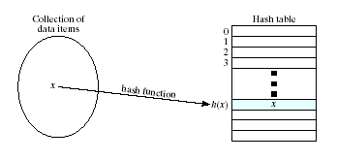
Hash Tables
Sometime faster search is needed
  Solution: use hashing
  Value of key field fed into a hash function
  Location in a hash table is calculated

Slide 4
Hashing
Key to hashing
  The hash function h(x)

Slide 5
Hash Functions
Simple function could be to mod the value of the key by some arbitrary integer
int h(int i)
{ return i % someInt; }
Note the max number of locations in the table will be same as someInt
Note that we have traded speed for wasted space
  Table must be considerably larger than number of items anticipated

Slide 6
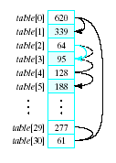
Problem of Hash Functions
Observe the problem with same value returned by h(i) for different values of i
  h(i)= i mod 31
  Called collisions
A simple solution is linear probing
  Linear search begins at
  collision location
  Continues until empty
  slot found for insertion

Slide 7
Hash Functions
When retrieving a value
linear probe until found
  If empty slot encountered
  then value is not in table
If deletions permitted
  Slot can be marked so
  it will not be empty and cause an invalid linear probe

Slide 8
Hash Functions
Strategies for improved performance
  Increase table capacity (less collisions)
  Use a different collision resolution technique
  Devise a different hash function

Slide 9
Hash Table Capacity
Size of table must be 1.5 to 2 times the size of the number of items to be stored
Otherwise probability of collisions is too high
Sometimes may be hard to get the estimate of the number of items

Slide 10
Collision Strategy: Linear Probing
h(x) = x % 31, the hash table has size of 31
  Insertion order of 620, 64, 128, 467, 777, 35, 127, 282
Exercise: Use linear probing to solve collision

Slide 11
Collision Strategy: Quadratic Probing
Linear probing can result in primary clustering
Consider quadratic probing
  Probe sequence from location i is
  i + 1, i – 1, i + 2^2, i – 2^2, i + 3^2, i – 3^2, …
  Exercise: using quadratic probing to solve
  Drawback: Secondary clusters can still form

Slide 12
Collision Strategy: Double Hashing
Double hashing
  Use a second hash function to determine probe sequence
  Two hash functions
    h1(x) = i
    h2(x) = k
    Probing sequence i, i+k, i+2k,….

Slide 13
Collision Strategy: Double Hashing
h(x) = x % 31, the hash table has size of 31
  Insertion order of 620, 64, 128, 467, 777, 35, 127, 282
Exercise: Use double hashing to solve collision
  h1(x) = x % 31
  h2(x) = 17 – (x % 17)

Slide 14
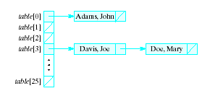
Collision Strategy: Chaining
Chaining
  Table is a list or vector of head nodes to linked lists
  When item hashes to location, it is added to that linked list

Slide 15
Improve the Hash Function
Ideal hash function
  Simple to evaluate
  Scatters items uniformly throughout table (reducing collision)
Modulo arithmetic not so good for strings
  Possible to manipulate numeric (ASCII) value of first and last characters of a name

Slide 16
Do you know any good hash function?
MD5 hashing, h(x)=16bytes
SHA-1 hashing, h(x)=20bytes
Hope you spend some time on googling these two to get a taste!!!!

Slide 17
Review
Why Hashing?
What does hashing do?
One problem of hashing: collision
  Degrade search performance
3 strategies to improve hashing performance
Collision Strategies
How to evaluate if a hash function is good?

